Slide 1
Data mining for Business Analytics
Logistic Regression & Model Evaluation
ISOM3360
Lab 4

Slide 2
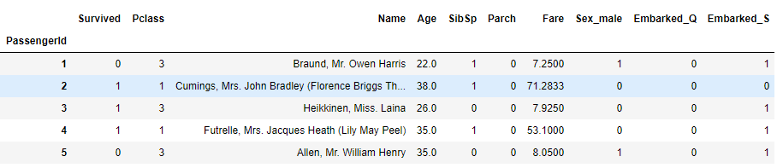
60% model Training
Training
40% model Testing
Model Building (using 100% training data, using best hyperparameters)
Apply Model
Predicting
10 folds
Cross Validation （test out best hyperparameters)
Predicting dataset: the value of target variable is UNKNOWN
Training dataset: the value of target variable is KNOWN

Slide 3
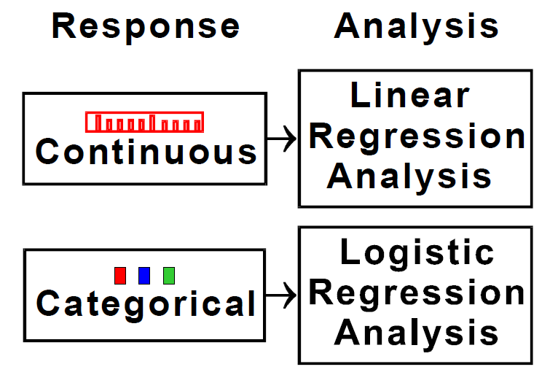
Overview

Slide 4

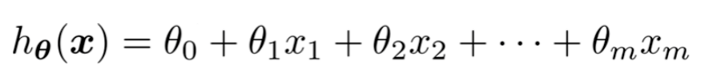
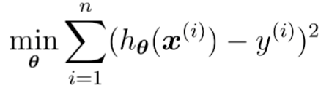
Linear Regression
Predict continuous number
Ordinary least squares (OLS)
Minimizes sum of squared errors

Slide 5
Example – Boston House Price
This dataset contains information collected by the U.S Census Service concerning housing in the area of Boston Mass. It was obtained from the StatLib archive (http://lib.stat.cmu.edu/datasets/boston) and has been used extensively throughout the literature to benchmark algorithms.
There are 14 attributes in each case of the dataset. They are:
CRIM - per capita crime rate by town
ZN - proportion of residential land zoned for lots over 25,000 sq.ft.
INDUS - proportion of non-retail business acres per town.
CHAS - Charles River dummy variable (1 if tract bounds river; 0 otherwise)
NOX - nitric oxides concentration (parts per 10 million)
RM - average number of rooms per dwelling
AGE - proportion of owner-occupied units built prior to 1940
DIS - weighted distances to five Boston employment centres
RAD - index of accessibility to radial highways
TAX - full-value property-tax rate per 10,000 dollars.
PTRATIO - pupil-teacher ratio by town
BLACK - 1000(Bk - 0.63)^2 where Bk is the proportion of blacks by town
LSTAT - % lower status of the population
MEDV - Median value of owner-occupied homes in 1000 dollars

Slide 6
Linear Regression (OLS)
Some cleaning – Standardization of features
Import Linear Regression from sklearn
Use default setting of Linear Regression from sklearn
# Import import preprocessing
from sklearn.linear_model import preprocessing
# Apply z-score normalization on all explanatory attributes
zscore_scaler = preprocessing.StandardScaler().fit(X)
X = pd.DataFrame(zscore_scaler.transform(X), columns = X.columns)
# Import Linear Regression Model from sklearn
from sklearn.linear_model import LinearRegression
lm = LinearRegression()

Slide 7
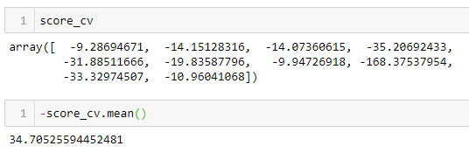
Linear Regression (OLS) - Evaluate
Cross validate the linear model based on Mean Squared Error
score_cv = cross_val_score(lm, X, y, scoring = 'neg_mean_squared_error', cv=10)

Slide 8
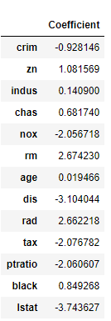
Linear Regression (OLS) - Coefficients
Train the linear regression model
Get the intercept (Theta_0)
Get the coefficients of independent attributes
lm.fit(X, y)
lm.intercept_
lm.coef_

Slide 9
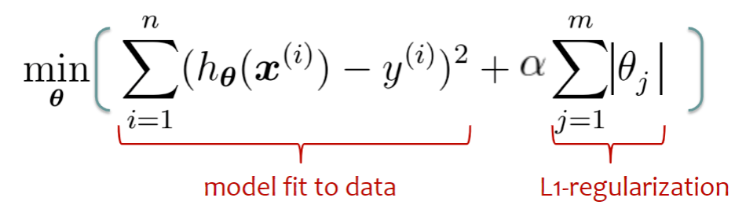
LASSO Regression
L1-regularization
Control the model complexity
Penalize for large magnitudes of coefficients

Slide 10
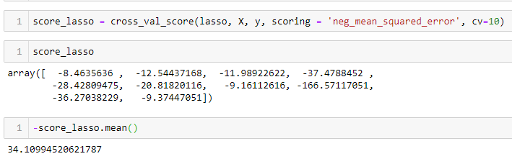
LASSO Regression
Import LASSO from sklearn
Define the Lasso model, set a value for alpha
Get the cross validate result
# Import Lasso Model from sklearn
from sklearn.linear_model import Lasso
# # Define model to be Lasso, set alpha=0.1 (alpha is the regularization parameter)
lasso = Lasso(alpha = 0.1)

Slide 11
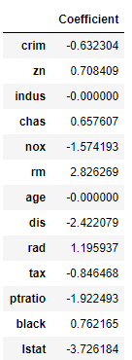
LASSO Regression
Fit the model
Get the intercept (Theta_0)
Get the coefficients of independent attributes
lasso.fit(X, y)
lasso.intercept_
lasso.coef_

Slide 12
Logistic Regression
Supervised learning
Result of probabilities, between 0 and 1
Normalize features
Import logistic regression from sklearn
# Import preprocessing
from sklearn.linear_model import preprocessing
# Apply z-score normalization on all explanatory attributes
zscore_scaler = preprocessing.StandardScaler().fit(X)
X_transform = pd.DataFrame(zscore_scaler.transform(X), columns = X.columns)
# Import Lasso Model from sklearn
from sklearn.linear_model import LogisticRegression

Slide 13
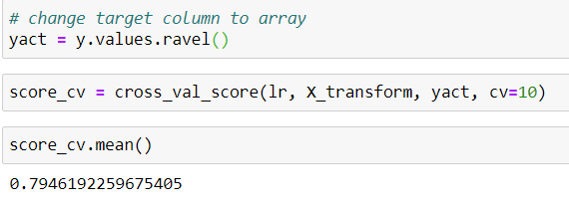
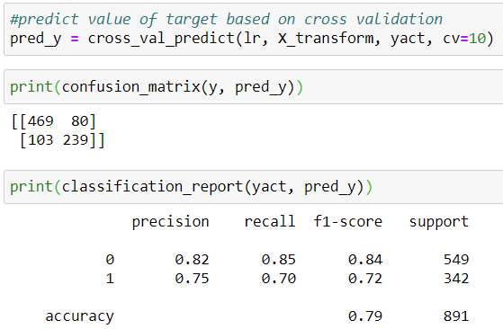
Logistic Regression
Define the Logistic Regression model, set a value for penalty and solver
Get the cross validate result
# define model to be logistic regression
# penalty='l1' means L1 regularization (recall LASSO regression); default is penalty ='L2' (L2 regularization).
# C=1.0 is inverse of regularization strength; must be a positive float.
# 'saga' is the algorithm to use in the optimization problem (finding the optimal coefficient values)
lr = LogisticRegression(penalty='l1', C=1.0, random_state=0, solver='saga')
Prediction through cross validation

Slide 14
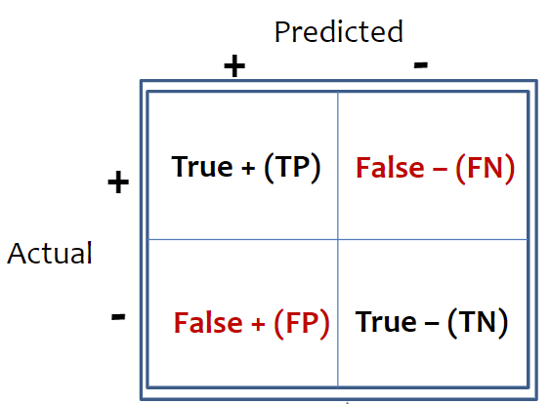
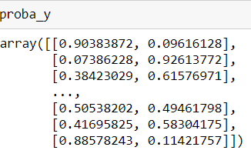
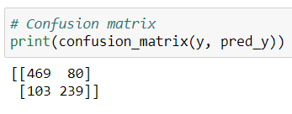
Confusion Matrix
Probabilities of each prediction
How do those probabilities being calculated in the tree structure?
proba_ = cross_val_predict(model, X_transform, yact, cv=10, method='predict_proba')
Probabilities of being 0
Probabilities of being 1
If by default the threshold to be 0.5

Slide 15
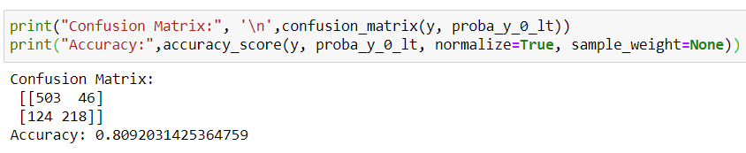
Prediction Probabilities
If we lower the threshold to 0.4 for class ‘0’
What about the confusion matrix and accuracy
# lower threshold for '0' to be 0.4, what about the prediction result
proba_y_0_lt = [0 if i >= 0.4 else 1 for i in proba_y_0]
proba_y_0_lt

Slide 16

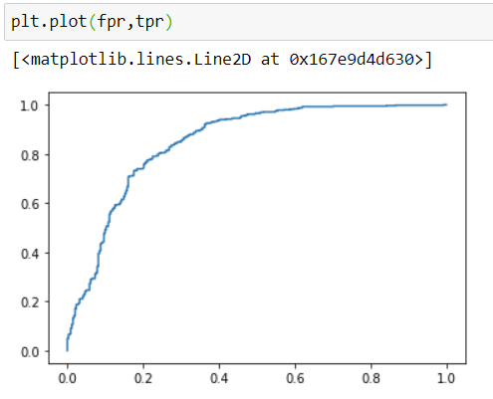
Construction ROC curve
Import libraries
from sklearn.metrics import roc_curve, auc
from sklearn import metrics
import matplotlib as mpl
import matplotlib.pyplot as plt
# calculate tpr and fpr based on different thresholds
fpr, tpr, thresholds = metrics.roc_curve(yact,proba_y_0,pos_label=0)

Slide 17
Decision Threshold and Misclassification cost
Why use different decision threshold?
Uneven cost, when FP and FN have different cost
If per FP cost is less then per FN cost, how do you want to adjust your threshold?
Total cost = FN * cost of per FN + FP * cost of per FP
Is there a threshold which generate least cost?

Slide 18
Logistic regression
Fit the model
Get the intercept (Theta_0)
Get the coefficients of independent attributes
# train model using training dataset
lr.fit(X_transform, yact)
# show the intercept of the trained model (Theta_0)
lr.intercept_
# show the coefficients of independent attributes
# the reason that we use the function .flatten() here is to convert the 8X1 array to 1X8 array
coeff_df = pd.DataFrame(lr.coef_.flatten(), X.columns, columns=['Coefficient'])
coeff_df

